Slide 1


Machine Learning
1
Copyright © www.ITbodhi.com
Notes:
1

Slide 2


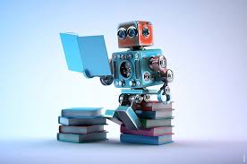
What is Machine Learning?
Copyright © www.ITbodhi.com

Slide 3
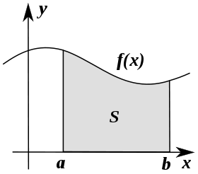

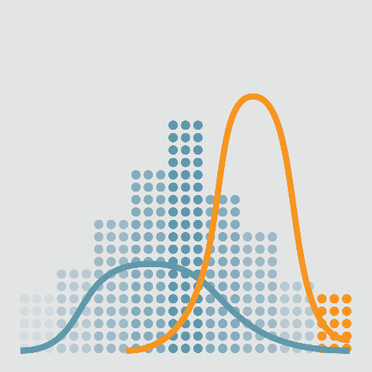


About the Program
Machine Learning Foundations:
Mathematics behind Machine Learning
Linear Algebra
Functions and Graphs
Calculus
Introduction to Probability Theory
Statistics and its Applications
Python
Copyright © www.ITbodhi.com

Slide 4
Getting Started with Machine Learning
What is Machine Learning
Numpy, Pandas, Scikit Tutorial
Introduction to Model Evaluation and Validation
Training and Testing
Metrics for Evaluation
Supervised Learning
Introduction to Supervised Learning
Linear Regression
Logistic Regression
Decision Trees
Random Forests
Naïve Bayes Classifier
Bayesian Statistics and Inference
K-Nearest Neighbor
Introduction to Neural Networks
Introduction to Natural language Processing
Copyright © www.ITbodhi.com

Slide 5
Unsupervised Learning
Introduction to Unsupervised Learning
K-Means Clustering
Hierarchal Clustering
Clustering Mini-Project
Feature Selection
Principal Components Analysis (PCA)
Feature Transformations
Natural Language Processing
Regular Expressions in Python
Tokenization
Topic Modeling
Named Entity Recognition
Build a chatbot from scratch
Copyright © www.ITbodhi.com

Slide 6
Amazon Web Services
IAM/S3/EC2
Databases
Machine Learning on AWS
Hyperparameters and Model Optimization
AWS Machine Learning Implementation with an Application
Projects covered during the course
Sentiment Analysis
Image classification
Handwritten Digits recognition
Chatbot from Scratch
Recommender System
Named Entity Recognition using Deep Learning Algorithms
Machine Learning Industry project using different Machine Learning techniques learned in the course.
Introduction to Kaggle Platform and other competitive platforms
Copyright © www.ITbodhi.com

Slide 7
ML Buzz word ! Suddenly ?
Huge data in digital form “Data is new Oil”
Computational capability
Recent progress in algorithms and theory
Copyright © www.ITbodhi.com

Slide 8
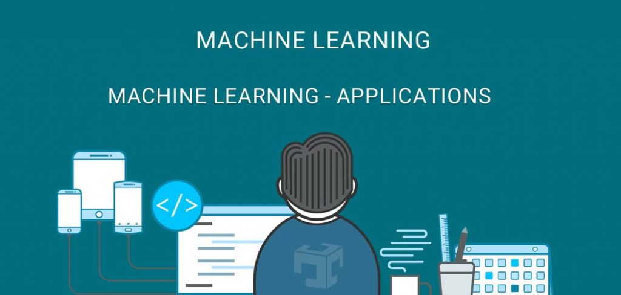

Slide 9
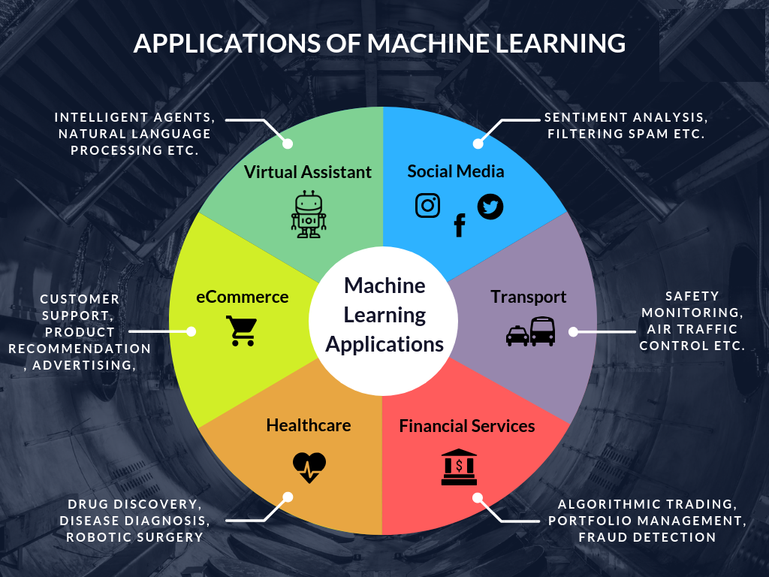
Few Applications
Copyright © www.ITbodhi.com

Slide 10
Few applications
Computer vision
Image Classification
Facial recognition technology
Optical character recognition
Natural language Processing
Language Translation
Spell check
Autocomplete
Voice text messaging
Spam filters
Related keywords on search engines
Siri, Alexa, or Google Assistant
Recommendation engines
Self-driving cars
News classification
Sensor Networks
Predictive maintenance
SPAM classification
Medical diagnosis
Credit scoring
Fraud detection
Market segmentation
Google page ranking
Collaborative filtering
Named entity recognition
Copyright © www.ITbodhi.com

Slide 11

Machine Learning is..
Field of study that gives computers the ability to learn without being explicitly programmed. ~ Arthur Samuel's definition from 1959
Machine learning is programming computers to optimize a performance criterion using example data or past experience.
~ Ethem Alpaydin
Well posed Learning Problem: A computer program is said to learn from experience E with respect to some task T and some performance measure P, if its performance on T, as measured by P, improves with experience ~ Tom Mitchell 1998
Copyright © www.ITbodhi.com

Slide 12
Machine Learning is…
The Broad: Machine Learning is the process of predicting things, usually based on what they’ve done in the past.
The Practical: Machine Learning tries to find relationships in your data that can help you predict what will happen next.
The Technical: Machine Learning uses statistical methods to predict the value of a target variable using a set of input data.
The Mathematical: Machine Learning attempts to predict the value of a variable Y given an input of feature set X.
Copyright © www.ITbodhi.com

Slide 13
Machine Learning
It is very hard to write programs that solve problems like recognizing a face.
We don’t know what program to write because we don’t know how our brain does it.
Even if we had a good idea about how to do it, the program might be horrendously complicated.
Instead of writing a program by hand, we collect lots of examples that specify the correct output for a given input.
A machine learning algorithm then takes these examples and produces a program that does the job.
The goal of ML is never to make “perfect” guesses, because ML deals in domains where there is no such thing. The goal is to make guesses that are good enough to be useful.
Copyright © www.ITbodhi.com

Slide 14
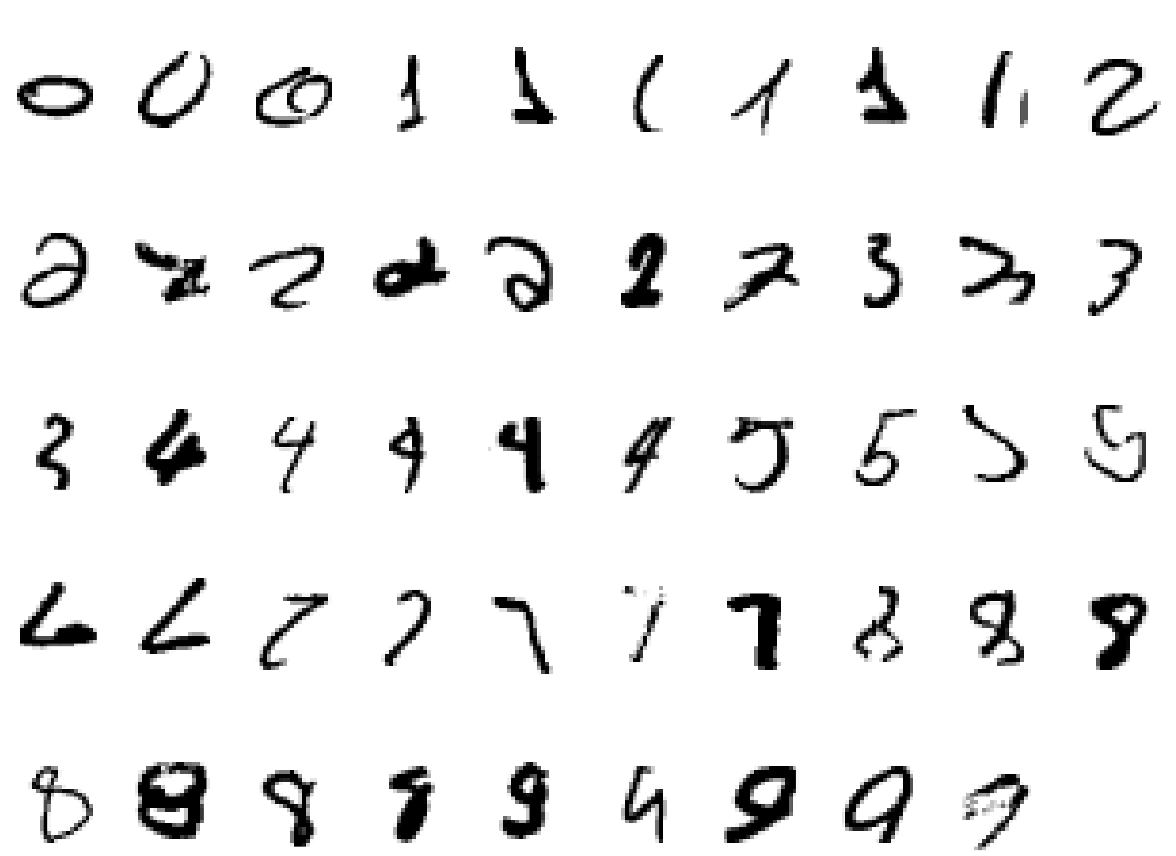
A classic example of a task that requires machine learning: It is very hard to say what makes a 2

Slide 15
Machine Learning
Machine Learning is the name given to generalizable algorithms that enable a computer to carry out a task by examining data rather than hard programming.
Subfield of computer science and artificial intelligence
Learn from data and help in making decisions and predictions based on that learning.
Data-driven decisions rather than being explicitly programmed to carry out a certain task.
Math provides models; understand their relationships and apply them to real-world objects.
Copyright © www.ITbodhi.com

Slide 16
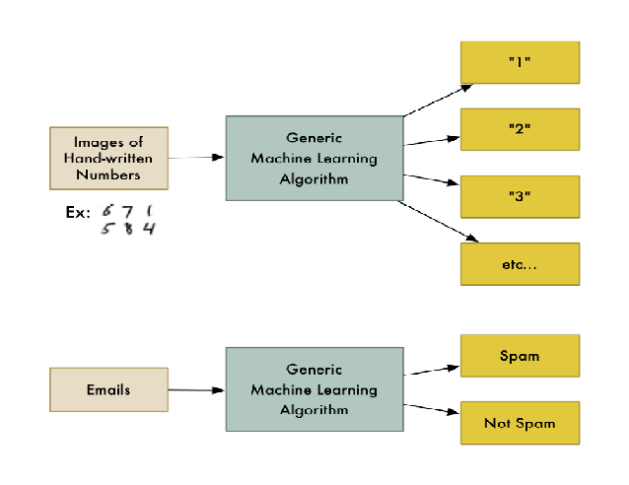
Machine Learning
Copyright © www.ITbodhi.com

Slide 17
Traditional Programming
Machine Learning
Data
Computer
Output
Program
Data
Computer
Program
Output
Copyright © www.ITbodhi.com

Slide 18
Machine Learning is…
ML solves problems that cannot be solved by numerical means alone.
past
future
predict
learn
Training
Data
model/
predictor
Testing
Data
model/
predictor
Copyright © www.ITbodhi.com

Slide 19
Where to apply ML?
Deterministic
These are the set of problems which have a pre-defined set of steps which solve them, every time.
Deterministic behavior or performance is specified and predictable. There’s no uncertainty.
E.g software written to dispense currency from an ATM machine.
Rules driven
Non-Deterministic
Either we don’t know enough about the problem or we don’t have enough computing power to model the problem.
Behavior has a degree of uncertainty and is somewhat unpredictable.
Human expertise does not exist (navigating on Mars),
Humans are unable to explain their expertise (speech recognition)
E.g. You can define few rules to classify a mail as SPAM or HAM and it may work on a given set of mails but a
new mail may arrive which may not follow the rules. In this case, you will have to modify the rules again.
Data driven
Machine Learning is an approach which uses data to identify patterns (learning) and solves the problem based on this learning. As new data comes in, the machine learning algorithm adjusts itself based on the data and start giving out results as per the new learning.
Copyright © www.ITbodhi.com

Slide 20
Jargons..
Statistics is just about the numbers, and quantifying the data. There are many tools for finding relevant properties of the data but this is pretty close to pure mathematics.
Data Mining is about using Statistics as well as other programming methods to find patterns hidden in the data so that you can explain some phenomenon. Data Mining builds intuition about what is really happening in some data and is still little more towards math than programming, but uses both.
Machine Learning uses Data Mining techniques and other learning algorithms to build models of what is happening behind some data so that it can predict future outcomes. It’s a particular approach to AI.
Deep Learning is one type of Machine Learning that achieves great power and flexibility by learning to represent the world as nested hierarchy of concepts, with each concept defined in relation to simpler concepts, and more abstract representations computed in terms of less abstract ones
Artificial Intelligence uses models built by Machine Learning and other ways to reason about the world and give rise to intelligent behavior whether this is playing a game or driving a robot/car. Artificial Intelligence has some goal to achieve by predicting how actions will affect the model of the world and chooses the actions that will best achieve that goal. Very programming based.
Copyright © www.ITbodhi.com

Slide 21
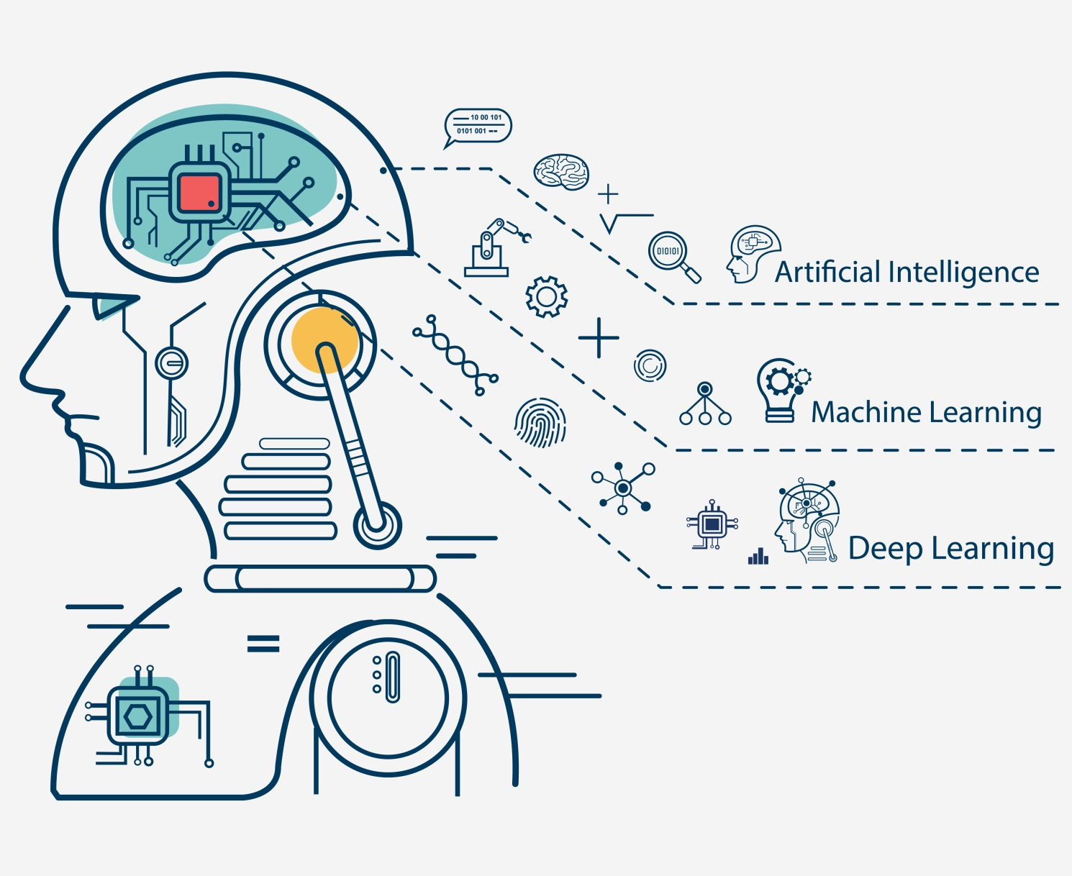
Copyright © www.ITbodhi.com

Slide 22
Jargons continued..
Artificial Intelligence
Narrow AI
General Intelligence
Machine Learning
Data Mining
NLP
Deep Learning
Image Processing
Voice Recognition
Copyright © www.ITbodhi.com

Slide 23

Copyright © www.ITbodhi.com

Slide 24
Foundation of Machine Learning
Role of Statistics: Statistics is a subfield of mathematics. We need statistics to help transform observations into information and to answer questions about samples of observations. in order to both understand the data used to train a machine learning model and to interpret the results of testing different machine learning models, that statistical methods are required.
Role of Computer science: Efficient algorithms to
Solve the optimization problem
Representing and evaluating the model for inference
Role of Mathematics: To build Mathematical model to solve the problem in efficient manner over which computer algorithms are designed.
Linear algebra is a sub-field of mathematics concerned with vectors, matrices, and linear transforms. It is a key foundation to the field of machine learning, from notations used to describe the operation of algorithms to the implementation of algorithms in code.
Calculus :Machine learning uses derivatives in optimization problems. Optimization algorithms like gradient descent use derivatives to decide whether to increase or decrease weights in order to maximize or minimize some objective.
Probability Theory: Probability theory is a mathematical framework for quantifying uncertainty about the world. It allows us (and our software) to reason effectively in situations where being certain is impossible. Probability theory is at the foundation of many machine learning algorithms.
Copyright © www.ITbodhi.com

Slide 25
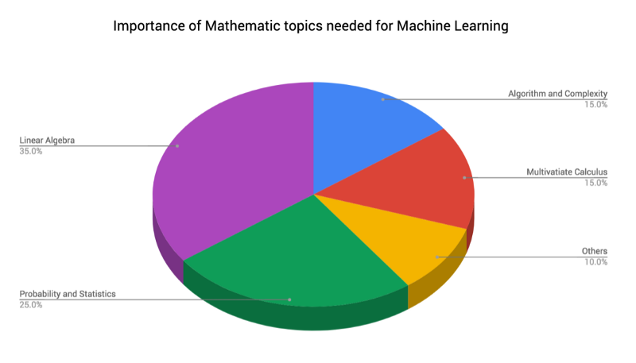
Foundation of Machine Learning
Copyright © www.ITbodhi.com

Slide 26
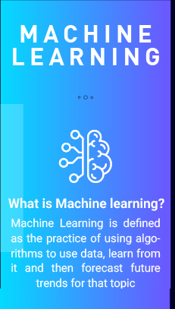
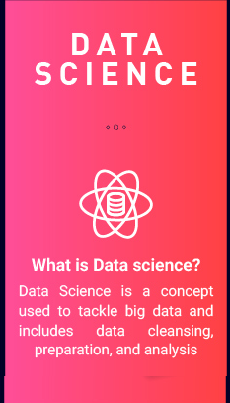
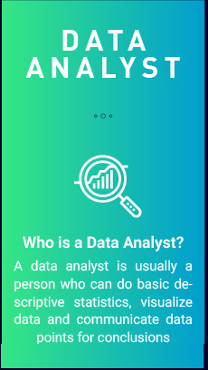
Copyright © www.ITbodhi.com

Slide 27
Data Science VS Machine Learning
Machine learning and statistics are part of data science and data science is much more than machine learning.
Data, in data science, may or may not come from a machine or mechanical process (survey data could be manually collected, clinical trials involve a specific type of small data) and it might have nothing to do with learning.
But the main difference is the fact that data science covers the whole spectrum of data processing, not just the algorithmic or statistical aspects.
In particular, data science also covers
data integration
distributed architecture
automating machine learning
data visualization
dashboards and BI
data engineering
deployment in production mode
automated, data-driven decisions
In many organizations, data scientists focus on only one part of this process
Copyright © www.ITbodhi.com

Slide 28

Types of Machine Learning
Copyright © www.ITbodhi.com

Slide 29
Supervised Learning
The purpose is to predict the value of a particular variable(target variable) based on values of some other variables(independent or explanatory variables).
Classification is used to predict the value of a discrete target variable while regression is used to predict the value of a continuous target variable.
To predict whether an email is spam or not is a Classification task while to predict the future price of a stock is a regression task.
They are called supervised because we are telling the algorithm what to predict.
E.g. Speech recognition, Spam classification, Fraud detection, Medical diagnosis, Face detection, Character Recognition, Speech Recognition, Weather Forecast etc.
Copyright © www.ITbodhi.com

Slide 30
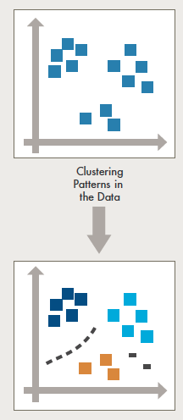
Unsupervised Learning
The purpose is to derive patterns that summarize the underlying relationships in data.
Association Analysis, Cluster Analysis and Anomaly detection are examples of Unsupervised Learning.
They are called unsupervised because in such cases, the final outcome is not known beforehand.
Example: Customer segmentation, Visual Recognition, predicting or understanding handwritten digits, clustering websites based on particular words count on each webpage
Copyright © www.ITbodhi.com

Slide 31








Unsupervised Learning: Face Recognition
Face Recognition
Training examples of a person
Test images
Copyright © www.ITbodhi.com

Slide 32
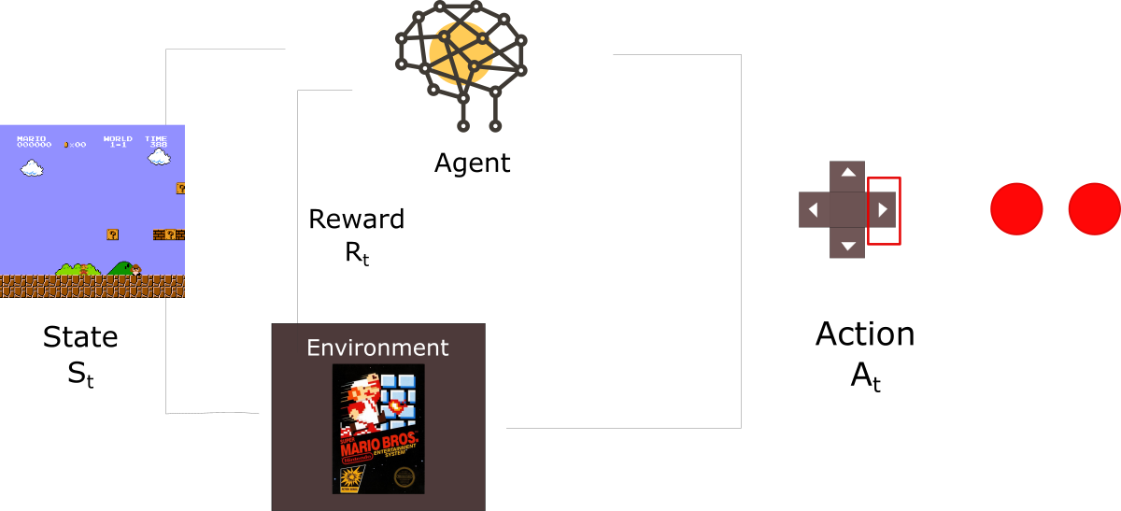
Reinforcement Learning
Reinforcement Learning allows the machine or software agent to learn its behavior based on feedback from the environment.
Learning a policy: A sequence of outputs
No supervised output but delayed reward
Game playing,Self Driving Cars, Gaming, Robotics
Let’s imagine an agent learning to play Super Mario Bros as a working example. The Reinforcement Learning (RL) process can be modeled as a loop that works like this:
Our Agent receives state S0 from the Environment (In our case we receive the first frame of our game (state) from Super Mario Bros (environment))
Based on that state S0, agent takes an action A0 (our agent will move right)
Environment transitions to a new state S1 (new frame)
Environment gives some reward R1 to the agent (not dead: +1)
This RL loop outputs a sequence of state, action and reward.
The goal of the agent is to maximize the expected cumulative reward.
Copyright © www.ITbodhi.com

Slide 33
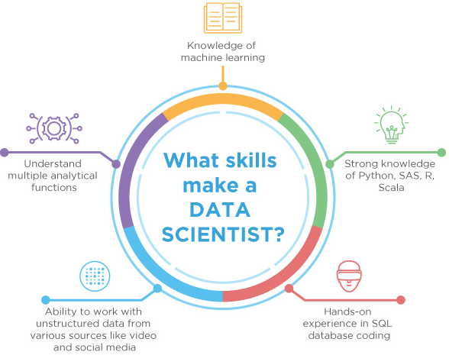
Skills to become a Data Scientist
Copyright © www.ITbodhi.com

Slide 34
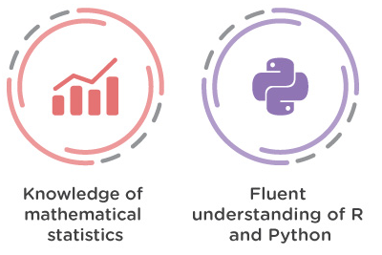
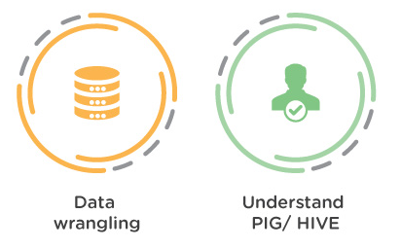
Skills to become a Data Analytics
Copyright © www.ITbodhi.com

Slide 35
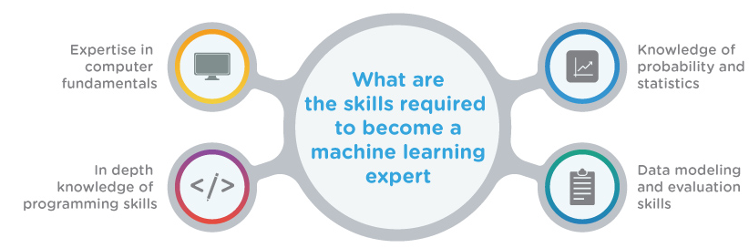
Skills to become a ML engineer
Copyright © www.ITbodhi.com

Slide 36

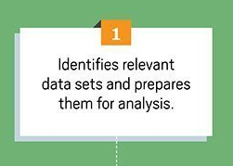
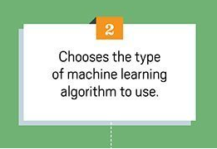
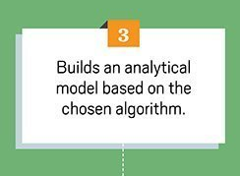
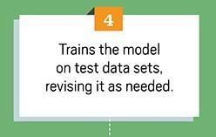
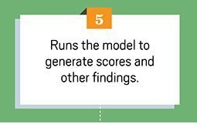
Copyright © www.ITbodhi.com

Slide 37
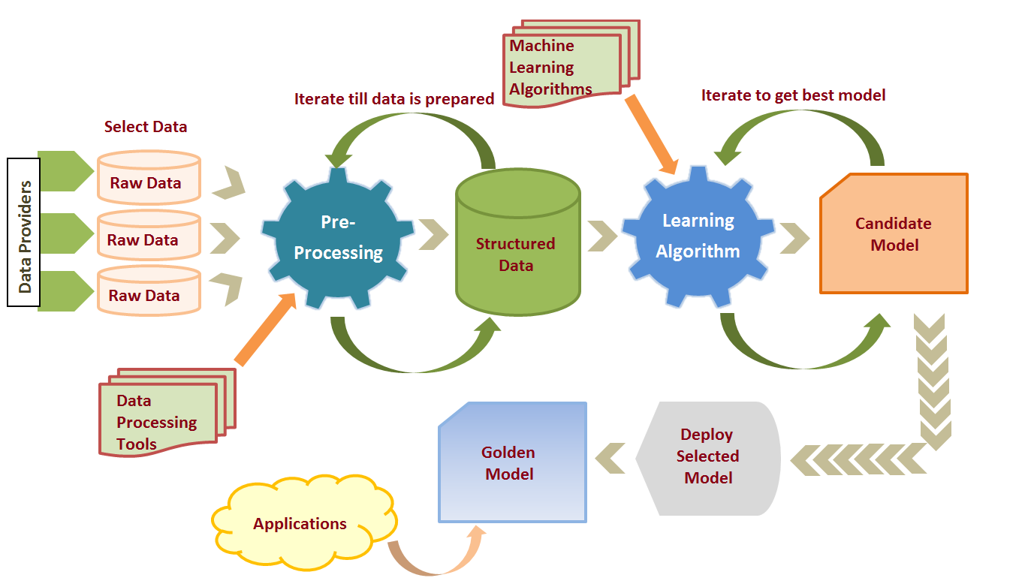
ML Life Cycle
Copyright © www.ITbodhi.com

Slide 38
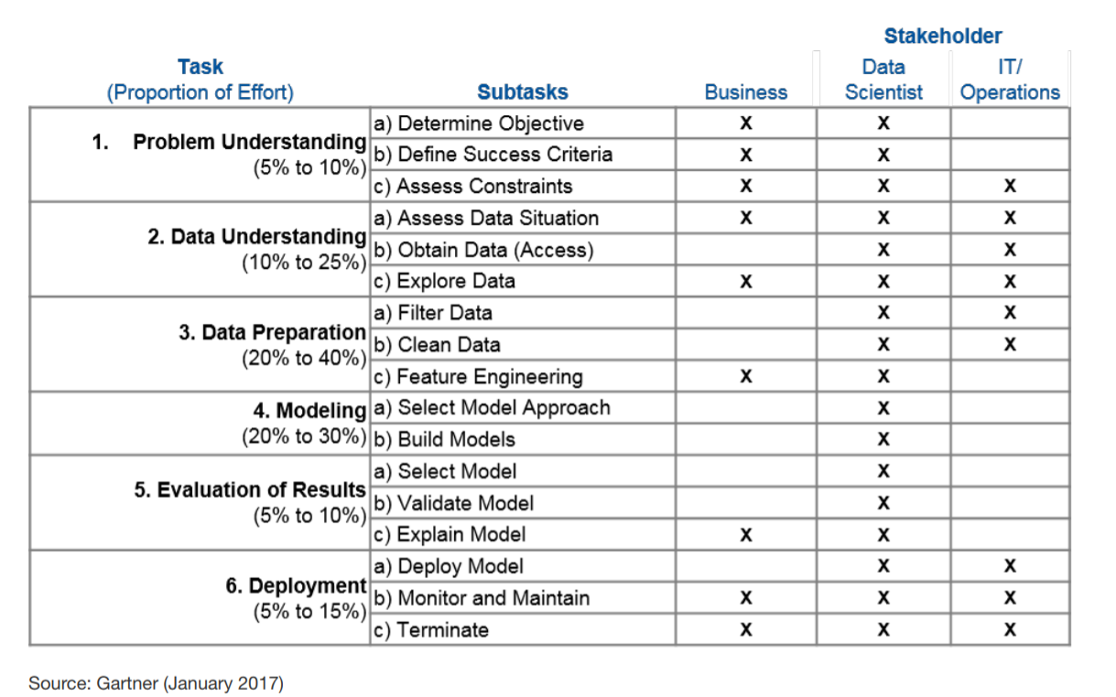
ML Effort Distribution
Copyright © www.ITbodhi.com

Slide 39
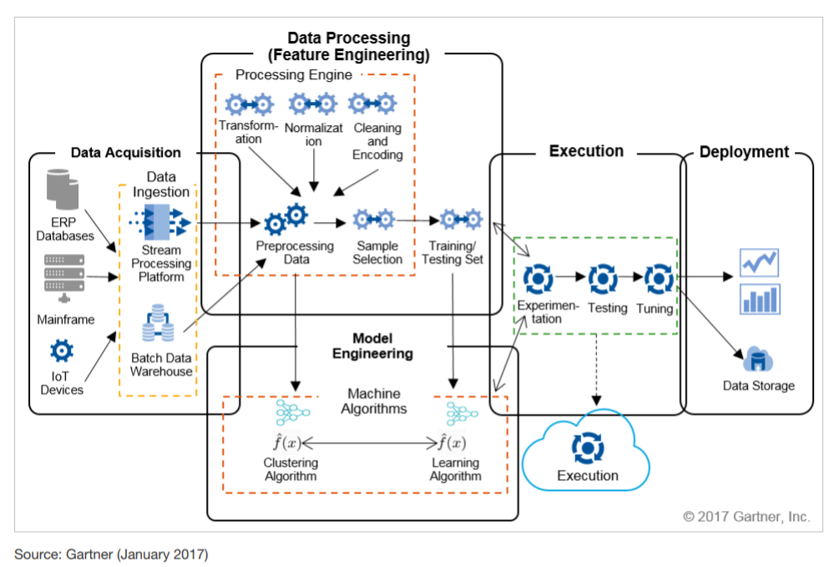
ML Architecture
Copyright © www.ITbodhi.com

Slide 40
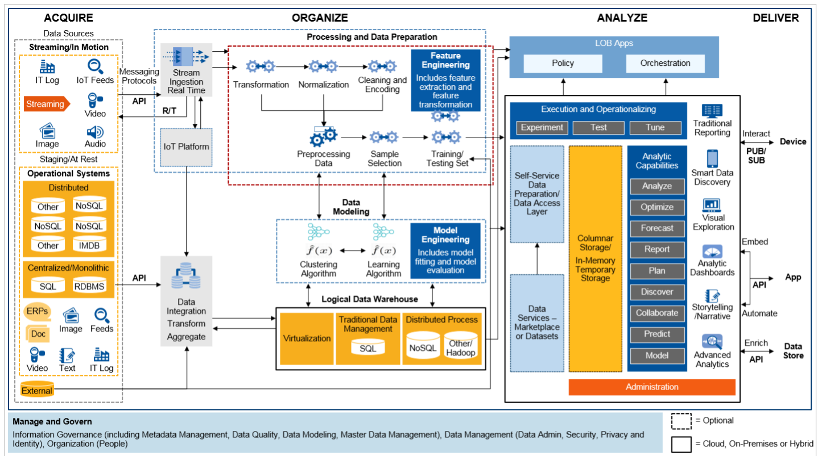
ML Architecture
Copyright © www.ITbodhi.com

Slide 41
Ps of Machine Learning
Probability
Passion
Patience
Copyright © www.ITbodhi.com

Slide 42
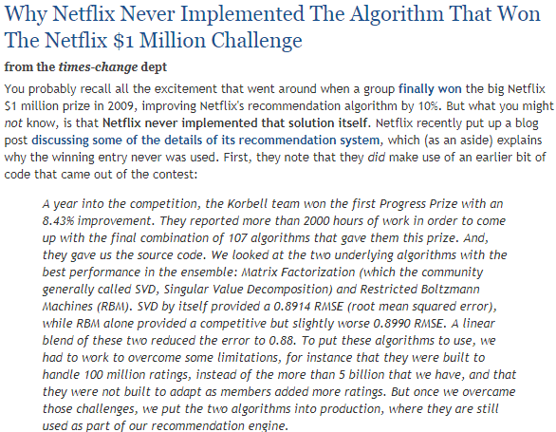
Copyright © www.ITbodhi.com

Slide 43
Data Analytics Architecture
DataFlow
NiFi
Analytics
Sci-Kit
Tensor Flow
AWS-ML
Spark
Machine Learning
Batch data loading
Sqoop
HADOOP – Data Storage
Traceability data
Change Management
Customer Complaint
Real time data loading
Die Fabrication data
Wafer Electrical data
Product Information
Kafka
Storm
Etc…
Sort Electrical Test data
Final Electrical Test Data
Flume
Copyright © www.ITbodhi.com

